Slide 1



Instant REST Services With RestExpress
Todd Fredrich

Slide 2

A Little About Me
Todd Fredrich
Product Architect
Pearson eCollege
Java guy since 1998…
C/C++ before that
10+ years of services experience
SOAP over JMS anyone?
Axis/Axis2
4+ years REST-ish experience

Slide 3

Quick Overview of REST
REST == “REpresentational State Transfer”
Simply and architectural style (Roy T. Fielding)
Embraces the web as it was meant to be used
Resource-based
Representations
Six constraints:
Uniform interface
Stateless
Client-server
Cacheable
Layered system
Code on demand

Slide 4
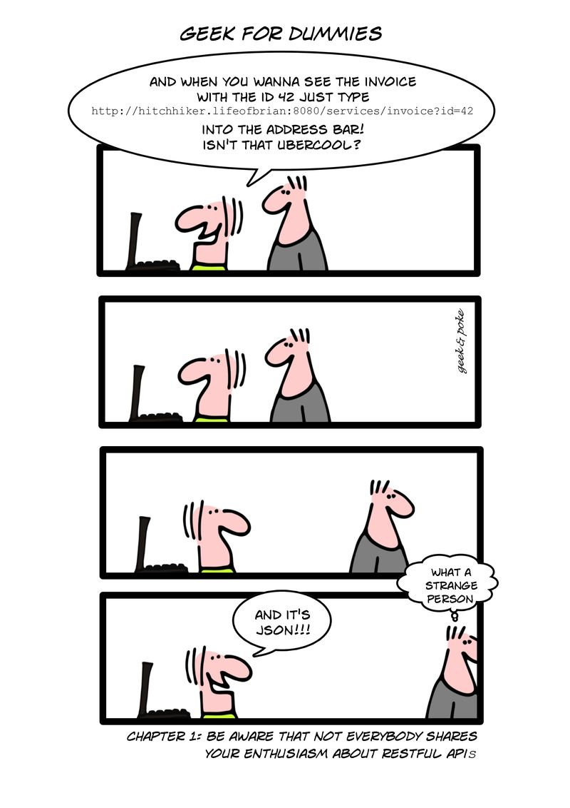

Slide 5
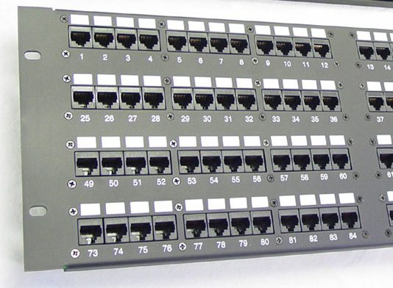
Uniform Interface
Identification of resources
Resource manipulation via representations
Hypermedia as the engine of application state (HATEOAS)
Self-descriptive messages

Slide 6
Identification of Resources
Identified by URIs
Multiple URIs may refer to same resource.
Naming URIs is key to usability [BEST PRACTICE]
Nouns vs. verbs (things vs. actions)
For example:
http://example.com/customers/42
http://example.com/customers/42/orders
http://example.com/customers/42/orders/33
http://example.com/processes/annual-tax-increase/2012

Slide 7
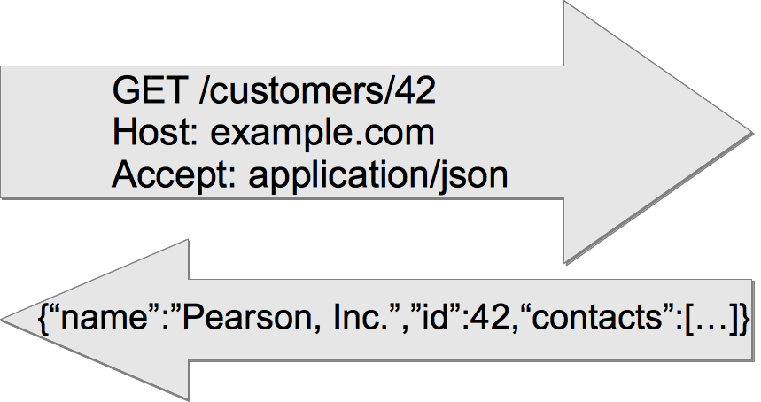
Resource Manipulation via Representations
Part of the resource state
Transferred between client and server
Typically JSON (historically XML)

Slide 8
Hypermedia As The Engine Of Application State (HATEOAS)
More advanced model
Recommend at a minimum, Location header on create:
Location: http://example.com/customers/43
Example “Order”:
{“id”:33,”items_sold”:3,”customer”:{”href”:”http://example.com/customers/42”},
“links”:[
{“rel”:”self”, ”href”: ”http://example.com/customers/42/orders/33”},
{“rel”:”related”,”title”:”order line-items”,”href”:”http://example.com/customers/32/orders/33/line-items”}
]}

Slide 9

Self-Descriptive Messages
Visibility due to:
Standard HTTP methods
Understandable resource names (URIs)
Control data (HTTP headers)
Media Types & negotiations
Returned data (representations)

Slide 10
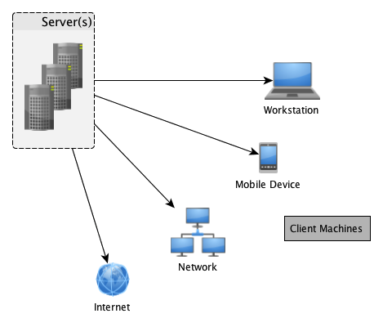
Stateless
Server contains no client state
Each request contains enough context to process the message
Self-descriptive messages
Any session state is held on the client
Client-Server
Assume a disconnected system
Separation of concerns
Uniform interface links the two

Slide 11
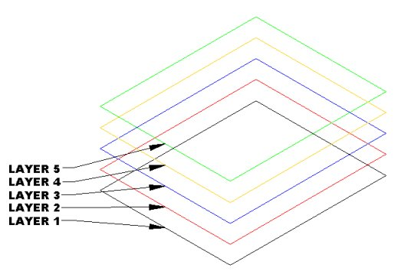
Cacheable
Server responses (representations) are cacheable
Implicitly
Explicitly
Negotiated
Layered System
Client can’t assume direct connection to server
Software or hardware intermediaries may exist between client and server
Improves scalability

Slide 12

Code on Demand
Server can temporarily extend client
Transfer logic to client
Client executes logic
For example:
Java applets
Executable JavaScript
The only optional constraint

Slide 13

Before REST (e.g. SOAP-RPC)
Customer Management Service
addNewCustomer()
getCustomerList()
getCustomerInfo()
updateCustomer()
deleteCustomer()
Order Management Service
createOrder()
updateOrder()
getOrderList()
getOrderInfo()
cancelOrder()
addOrderItem()
removeOrderItem()

Slide 14
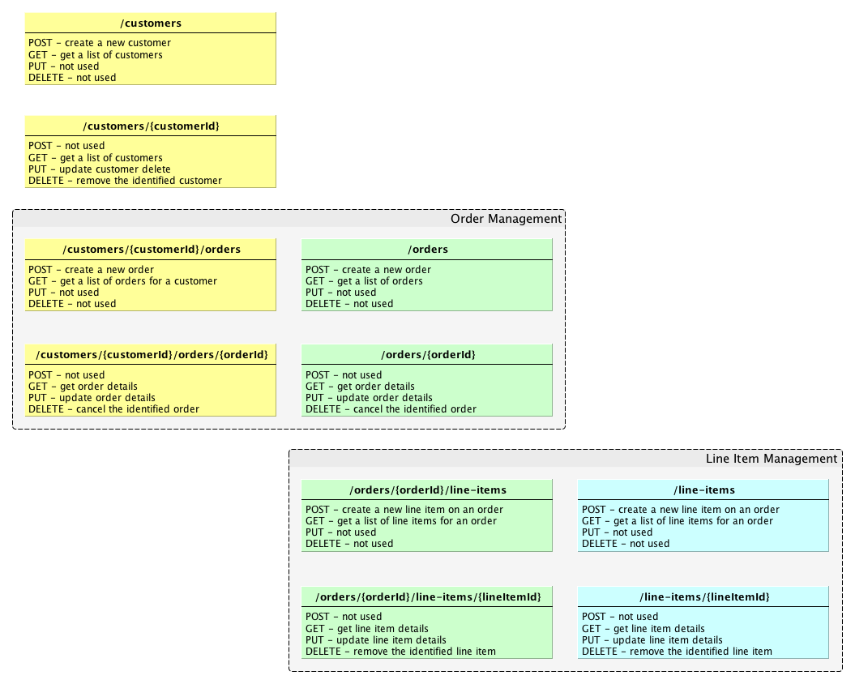


Slide 15
REST Best Practice Quick Tips
Use HTTP verbs to mean something
GET (read)
PUT (update)
DELETE (uh… delete/remove)
POST (create, plus others)
OPTIONS (for documentation)
Sensible resource names (nouns only)
JSON (+ XML)
Fine-grained resources
Support caching
Support pagination (limit, offset, with sensible limit default)
Consider connectedness (HATEOAS)
Location headers on create (minimal)
Links and pagination

Slide 16
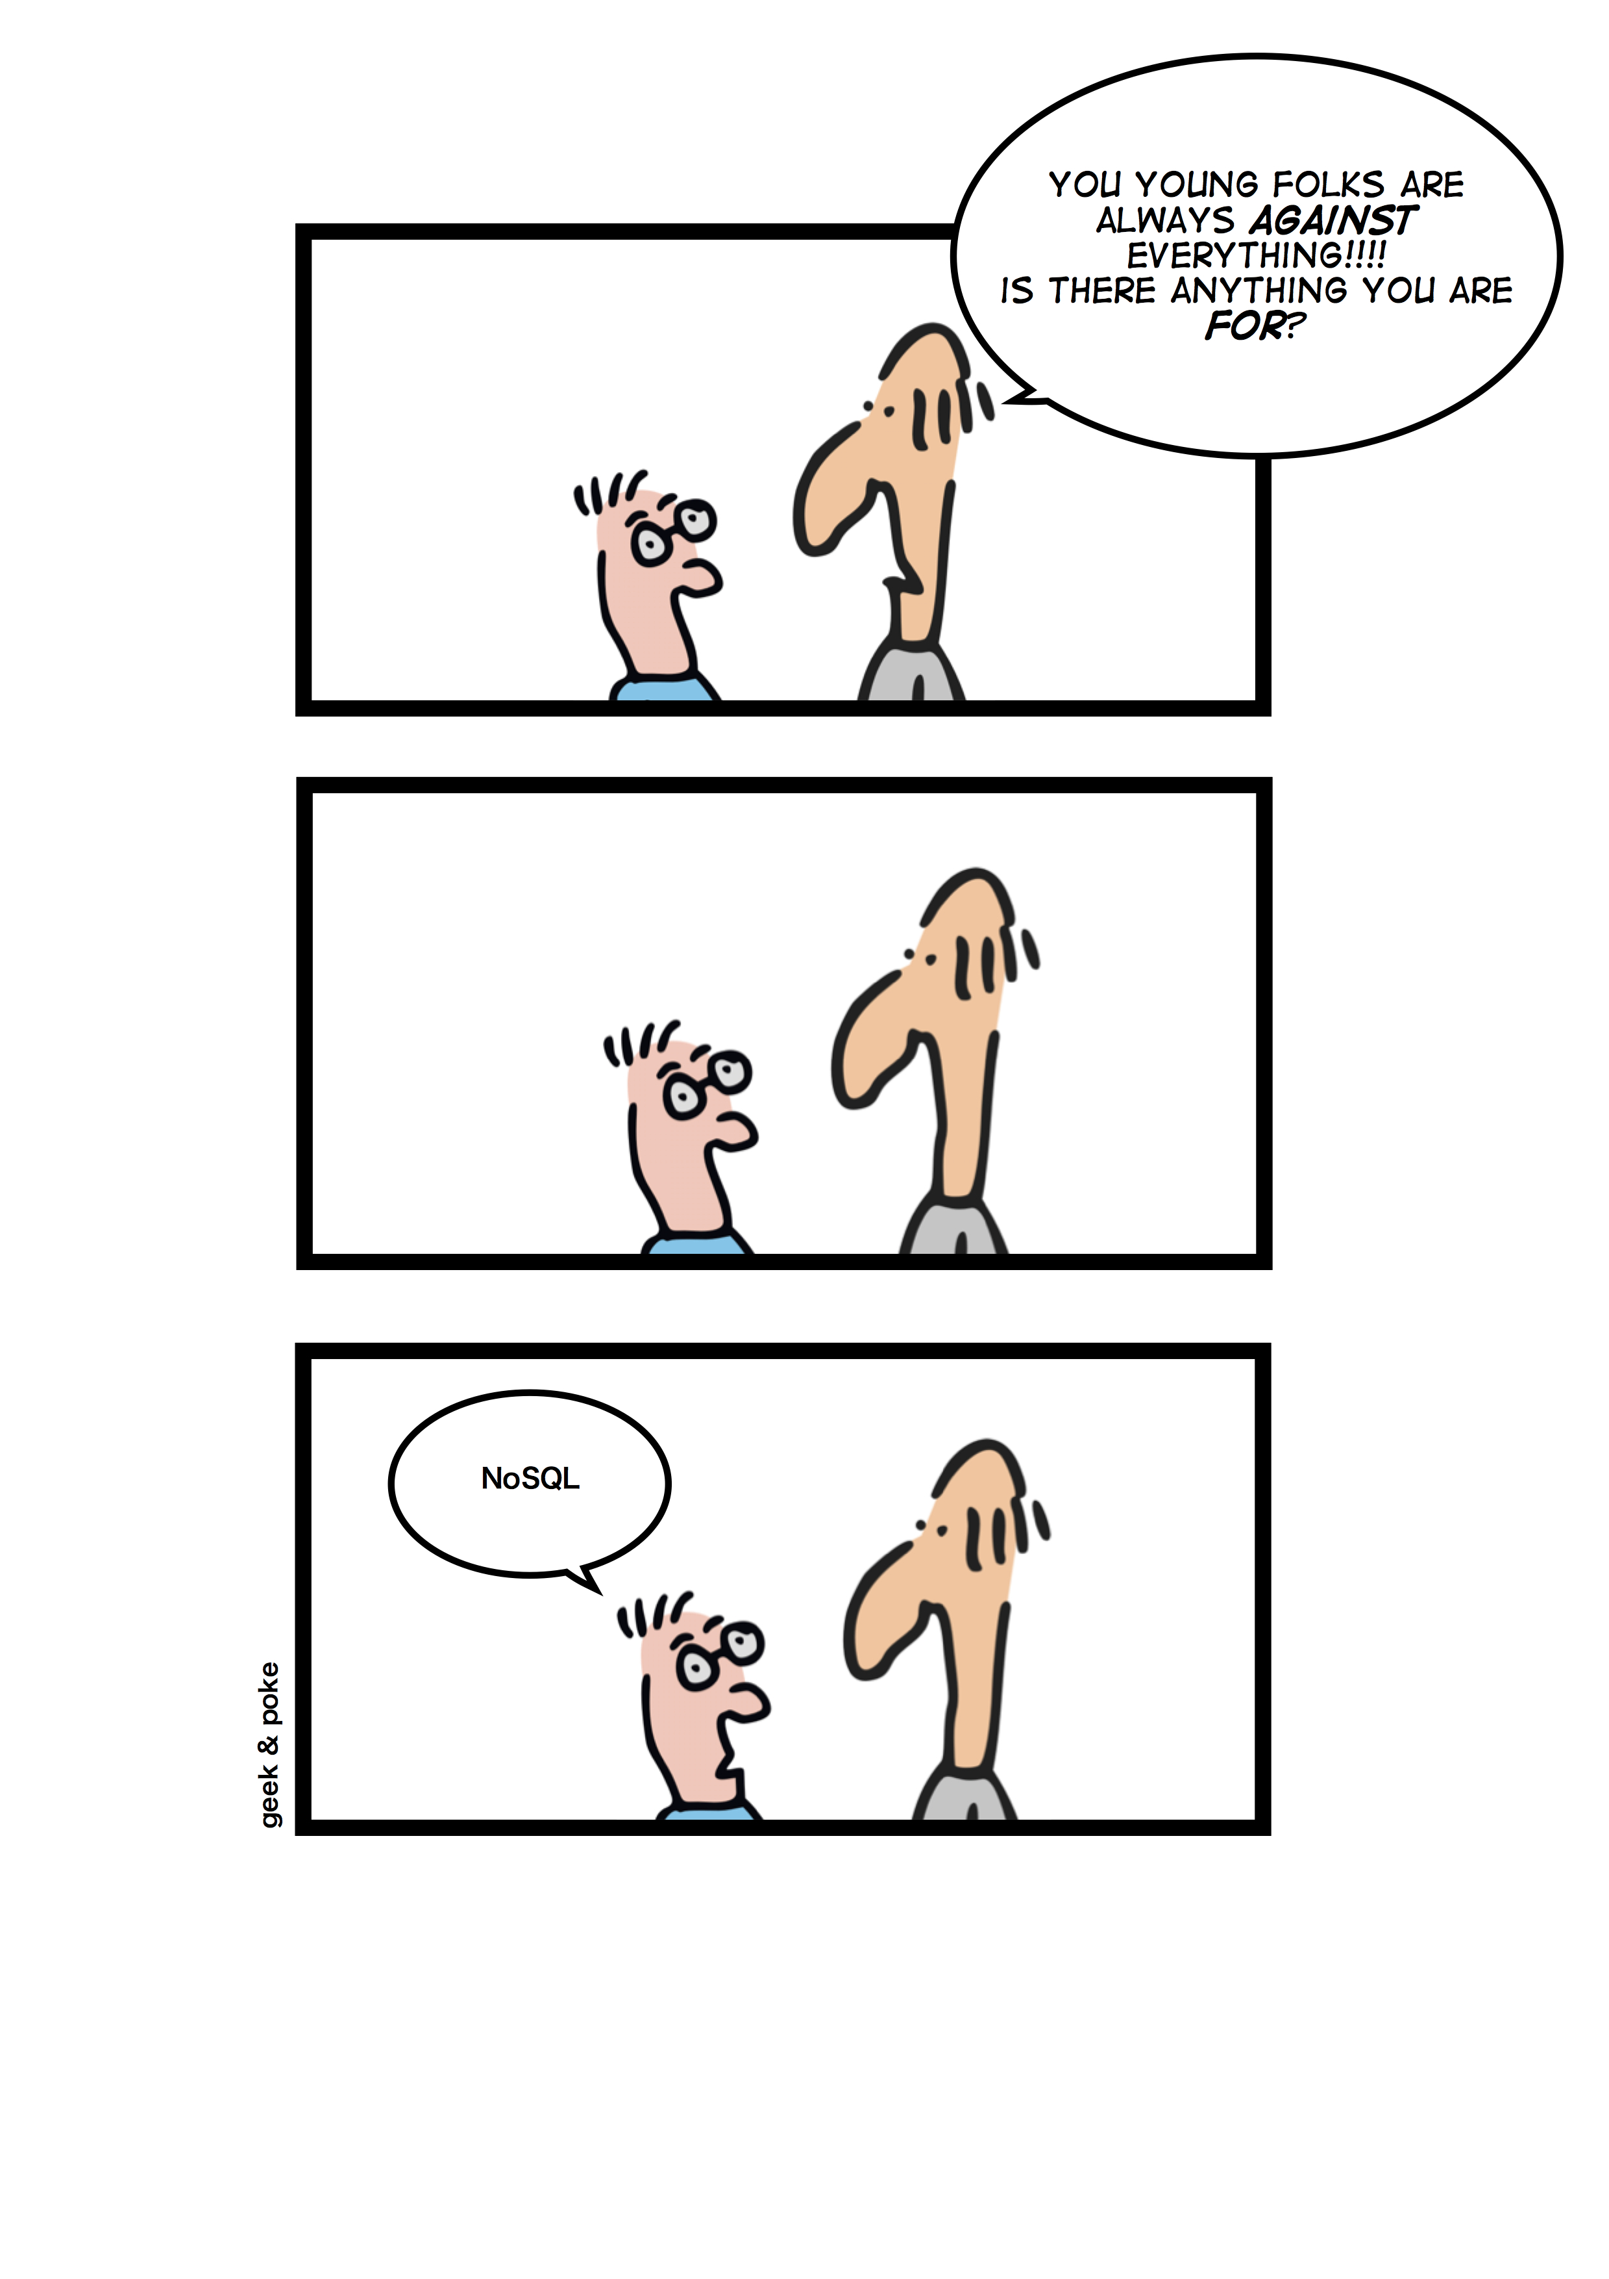

Slide 17
Why NoSQL?
Scalability
Options:
Key/value – Voldemort, Redis, Riak
Document – CouchDB, MongoDB
Graph – Neo4J, Titan, FlockDB
Column-family – Dynamo, BigTable, Cassandra
MongoDB Strengths
Easy to install and use
Searchable/indexable
Clusters and sharding
Native BSON storage

Slide 18








What is RestExpress?
Simplest thing that could possibly work…
Java-based REST framework
Uses Netty NIO framework as its HTTP server
Convention over configuration
ISO8601 time point handling in JSON/XML
Heavily influenced by:

Slide 19
The Default RestExpress Stack
HTTP: Netty NIO
JSON Processing: GSON (can easily plugin Jackson)
XML Processing: XStream (can plugin Jackson)
O/R Mapping: Morphia
MongoDB Driver: Mongo Java Driver
Domain Validation: Syntaxe
ISO 8601 Date Support: DateAdapterJ
Intra-JVM Messaging: Domain-Eventing
Hypermedia Linking: HyperExpress
RSS/Atom Feed Support: AtomExpress
Available at: https://github.com/RestExpress
Scaffold (kickstart) Application at: https://github.com/RestExpress/RestExpress-Scaffold/downloads

Slide 20
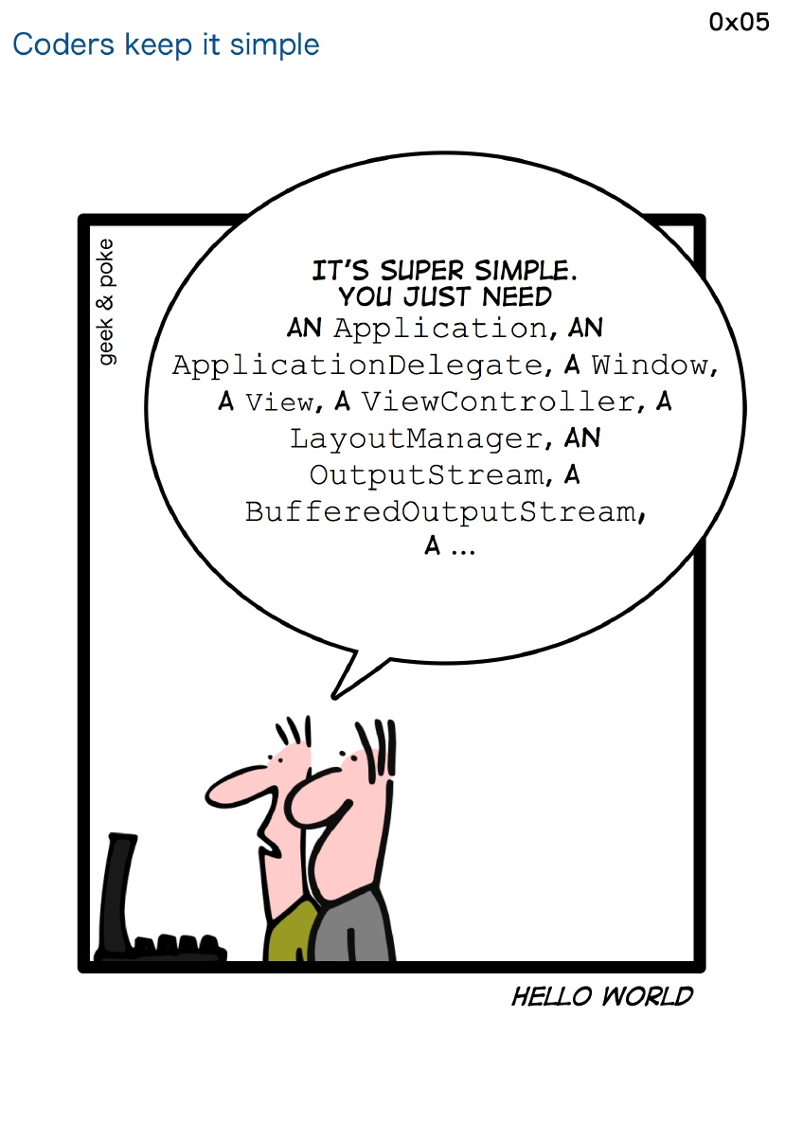

Slide 21
A Minimal RestExpress Server
public class Echo {
public static void main(String[] args) {
RestExpress server = new RestExpress();
server.uri("/echo", new Object() {
public String read(Request request, Response response) {
String value = request.getRawHeader("echo");
response.setContentType("text/xml");
if (value == null) {
return "<echo><error>no value specified</error></echo>";
}
else {
return String.format("<echo><value>%s</value></echo>", value);
}
}
})
.method(HttpMethod.GET)
.noSerialization();
server.bind(8000);
server.awaitShutdown();
}
}

Slide 22
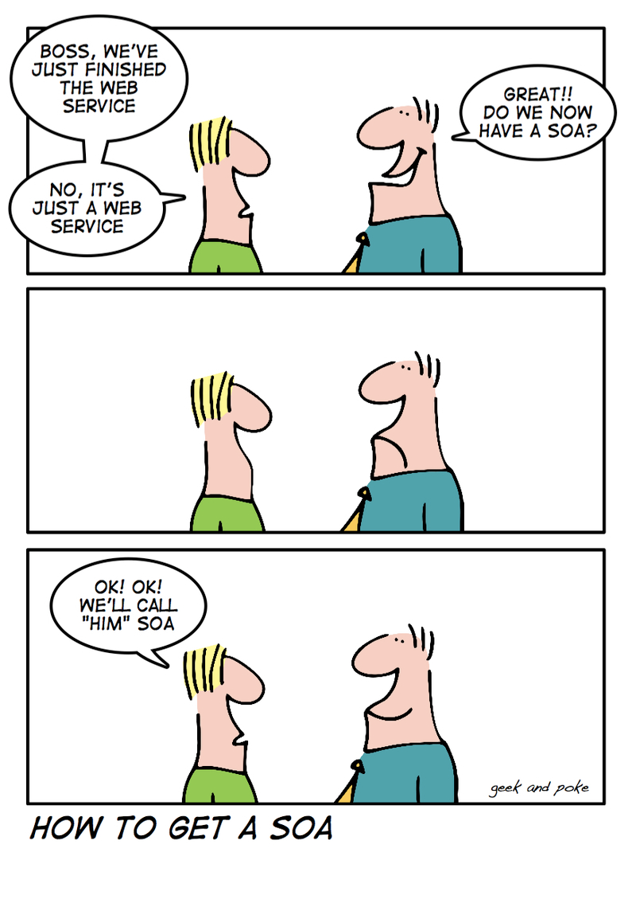

Slide 23

Our Project: Blogging Service Suite
Possibly overdone, but easily understood
New technology stack hard enough
3 domain objects: Blog, Entry, Comment
CRUD in MongoDB
Domain validation (“requiredness”)
Error handling (proper HTTP statuses)
Caching support
Location header on create
Pagination
Sorting & filtering
Maybe Even:
Relational Links
Asynchronous cascade-delete

Slide 24
Starting the Project
Working Example Code at:
https://github.com/tfredrich/PTS-2012-Blogging
Zip file: https://github.com/tfredrich/PTS-2012-Blogging/downloads
Normally: Download the Scaffolding Project
https://github.com/RestExpress/RestExpress-Scaffold/downloads
Unzip the file into a directory
Rename the ‘kickstart’ directory, if desired
Import into Eclipse IDE
Install and run MongoDB
‘ant run’ in console (or run as Java App in Eclipse IDE)
http://localhost:8081/routes/metadata.json
http://localhost:8081/routes/metadata.xml

Slide 25
Your response should look something like this:
curl -i localhost:8081/routes/metadata
HTTP/1.1 200 OK
Content-Type: application/json; charset=UTF-8
Content-Length: 927
{"name":"RESTful Kickstart","port":8081,"supportedFormats":["json","xml"],"defaultFormat":"json","routes":[{"uri":{"pattern":"/orders.{format}","parameters":["format"]},"defaultFormat":"json","methods":["POST","GET"],"isSerialized":true},{"name":"KickstartOrderUri","uri":{"pattern":"/orders/{orderId}.{format}","parameters":["orderId","format"]},"defaultFormat":"json","methods":["GET","PUT","DELETE"],"isSerialized":true},{"name":"allRoutesMetadata","uri":{"pattern":"/routes/metadata.{format}","parameters":["format"]},"defaultFormat":"json","methods":["GET"],"isSerialized":true},{"name":"singleRouteMetadata","uri":{"pattern":"/routes/{routeName}/metadata.{format}","parameters":["routeName","format"]},"defaultFormat":"json","methods":["GET"],"isSerialized":true},{"name":"routesConsole","uri":{"pattern":"/routes/console.html"},"supportedFormats":["html"],"defaultFormat":"json","methods":["GET"],"isSerialized":false}]}

Slide 26
Or in XML:
curl -i localhost:8081/routes/metadata.xml
HTTP/1.1 200 OK
Content-Type: application/xml; charset=UTF-8
Content-Length: 2161
<service>
<name>RESTful Kickstart</name>
<port>8081</port>
<supportedFormats>
<string>json</string>
<string>xml</string>
</supportedFormats>
<defaultFormat>json</defaultFormat>
<routes>
<route>
<uri>
<pattern>/orders.{format}</pattern>
<parameters>
<string>format</string>
</parameters>
…

Slide 27
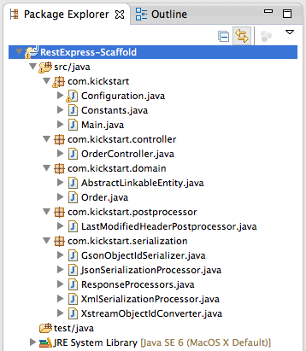
Notes:
Point out the major packages and why everything’s broken out—for best practices and good design. Red arrows and/or circles around the point we’re trying to make.

Slide 28
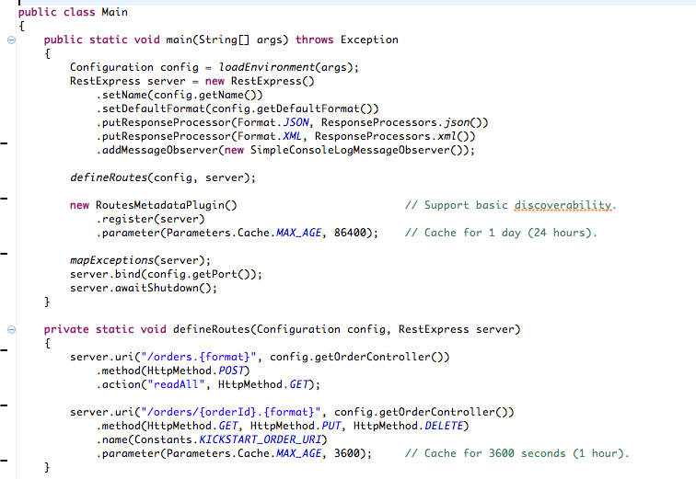
Notes:
What’s going on in this “main()” method?

Slide 29
Our First Domain Object: Blog
Using the Order-related objects as templates
Route(s)
POST|GET /blogs.{format}
GET|PUT|DELETE /blogs/{blogId}.{format}
Domain object: Blog
Repository (+ Interface?)
Controller
Blog data elements
Validation
Modeling relationships (e.g. entries)

Slide 30
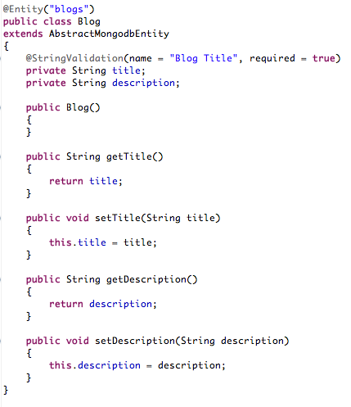

Slide 31
What’s Next: Entry
Routes
/blogs/{blogId}/entries.{format}
/blogs/{blogId}/entries/{entryId}.{format}
Domain object: Entry
Controller
Service (?)
Repository
Data elements
Validation
Modeling relationships (e.g. comments)

Slide 32
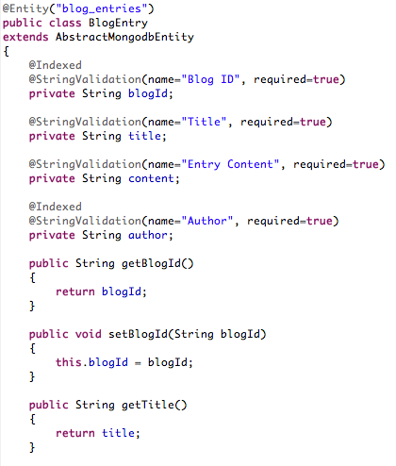

Slide 33
What’s Next: Comment
Routes
/blogs/{blogId}/entries/{entryId}/comments.{format}
/blogs/{blogId}/entries/{entryId}/comments/{commentId}.{format}
Domain object: Entry
Controller
Service (?)
Repository
Data elements
Validation

Slide 34
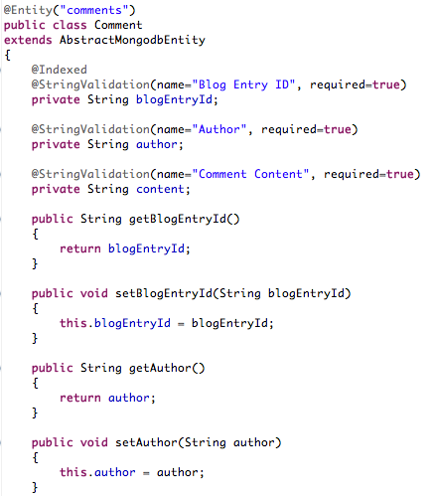

Slide 35
Pagination Support
Best practices:
Query-string parameters, limit and offset
Or Range header (e.g. ‘Range: items=0-19’)
Response header: Content-Range: 0-19/50
QueryRange class
QueryRange.parseFrom(Request r)
QueryRange.parseFrom(Request r, int limit)
QueryRange.asContentRange(int count)

Slide 36
Filtering Support
Best practices:
Query-string parameter, “filter”
Name/value separator, double colons (“::”)
Pair separator, verticle bar (“|”)
Example:
…/customers?filter=city::Denver|country::USA
QueryFilter Class
QueryFilter.parseFrom(Request r)
QueryFilter.hasFilters()
QueryFilter.iterate(FilterCallback c)
FilterCallback Interface
filterOn(FilterComponent c)

Slide 37
Sorting/Ordering Support
Best practices:
Query-string parameter, “sort”
Implied order is ‘ascending’
Descending indicator is a prefix dash (“-”)
sort separator, verticle bar (“|”)
Example:
…/orders?sort=customer_name|-total
QueryOrder Class
QueryOrder.parseFrom(Request r)
QueryFilter.isSorted()
QueryFilter.iterate(OrderCallback c)
OrderCallback Interface
orderBy(OrderComponent c)

Slide 38
Hypermedia Linking
HyperExpress project
Classes
Link
LinkableObject – wrapper for class links
LinkableCollection – wrapper for collections
Interface
Linkable – defines the interface for LinkableObject and LinkableCollection
Helpers
LinkUtils
MapStringFormat

Slide 39
Error Handling
RestExpress uses RuntimeException
server.mapException(from<Throwable>, to<ServiceException>)
Mapping Exceptions to HTTP Statuses
ServiceException → 500
BadRequestException → 400
ConflictException → 409
ForbiddenException → 403
HttpSpecificationException → 500
MethodNotAllowedException → 405
NotFoundException → 404
UnauthorizedException → 401
Need Another?
Extend ServiceException
Call super(<integer http status code>) in constructor.

Slide 40
Wrapped Responses
Why?
AJAX (browser) clients
Error conditions
What?
Wrap response data in envelope
JSEND
Success: {“status”:”success”,”code”:201,”data”:”<json>”}
Error: {“status”:”error”,”code”:400,”data”:”BadRequestException”, “message”:”Could not parse JSON input”}
Failure: {“status”:”fail”,”code”:500,”data”:”NullPointException”}
How?
server.putResponseProcessor(String format, ResponseProcesor rp)
ResultWrapper.fromResponse(Response r)

Slide 41
RestExpress Stack Links
https://netty.io/
http://code.google.com/p/google-gson/
http://xstream.codehaus.org/
http://code.google.com/p/morphia/)
https://github.com/mongodb/mongo-java-driver/downloads
https://github.com/RestExpress/Syntaxe
https://github.com/tfredrich/DateAdapterJ
https://github.com/tfredrich/Domain-Eventing
https://github.com/RestExpress/HyperExpress
https://github.com/RestExpress
https://github.com/RestExpress/RestExpress-Scaffold

Slide 42
Additional Resources:
REST API Design Rulebook, Mark Masse, 2011, O’Reilly Media, Inc.
RESTful Web Services, Leonard Richardson and Sam Ruby, 2008, O’Reilly Media, Inc.
RESTful Web Services Cookbook, Subbu Allamaraju, 2010, O’Reilly Media, Inc.
REST in Practice: Hypermedia and Systems Architecture, Jim Webber, et al., 2010, O’Reilly Media, Inc.
Service Design Patterns, Robert Daigneau, 2012, Pearson Education, Inc.
SOA with REST, Thomas Erl, et. al., 2013, SOA Systems Inc.
NoSQL Distilled, Pramod J. Sadalage and Martin Fowler, 2013, Pearson Education, Inc.
http://www.RestApiTutorial.com/
https://github.com/RestExpress

